Slide 1
Chapter 6.5
Factoring Trinomials (A≠1)
ALGEBRA CONCEPTS

Slide 2
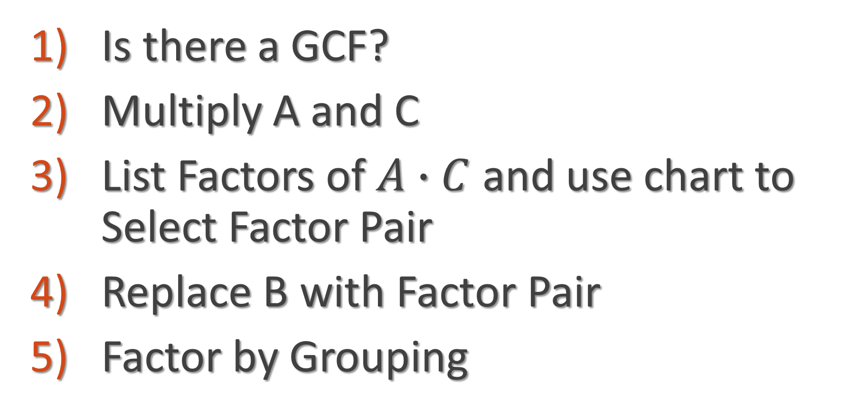

Factoring a Trinomial
$${Ax}^{2}+Bx+C$$
Is there a GCF?
Multiply A and C
List Factors of $A∙C$ and use chart to Select Factor Pair
Replace B with Factor Pair
Factor by Grouping

Slide 3
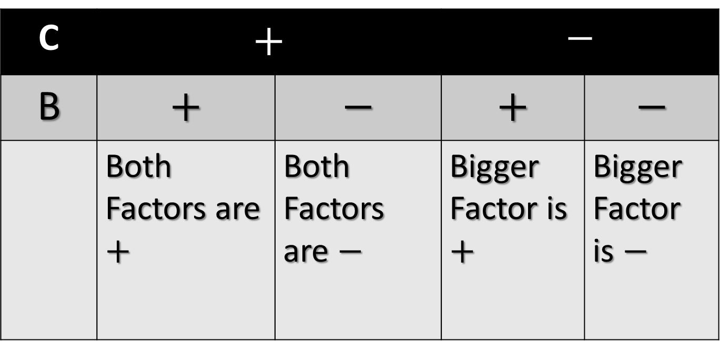

SIGN CHART
C | $$+$$ |  | $$−$$
B | $$+$$ | $$−$$ | $$+$$ | $$−$$
 | Both Factors are $+$ | Both Factors are $−$ | Bigger Factor is $+$ | Bigger Factor is $−$

Slide 4
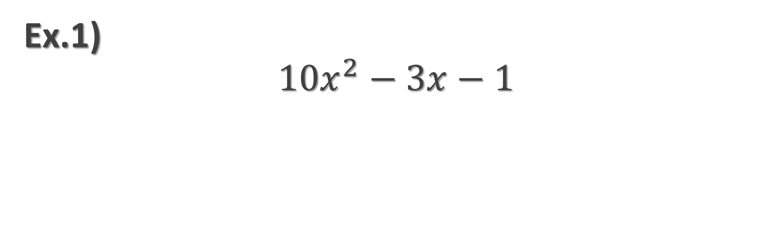
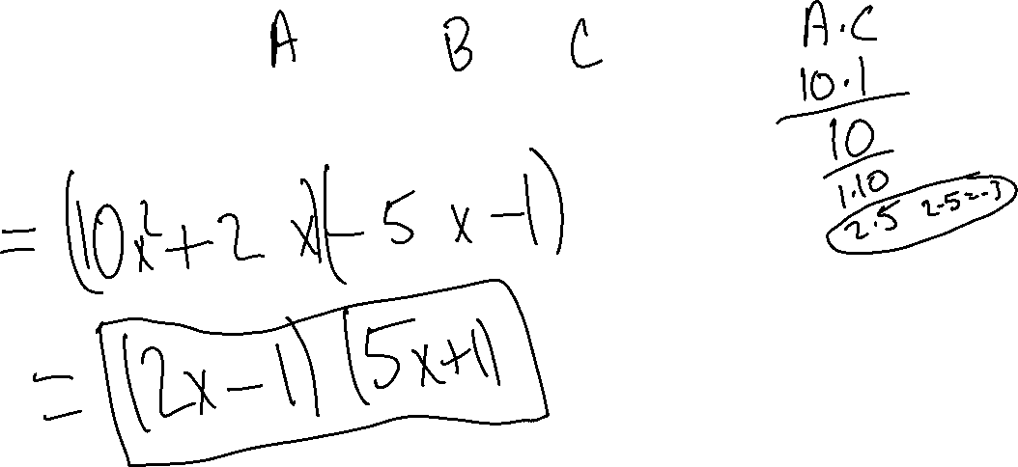
Ex.1)
$${10x}^{2}−3x−1$$

Slide 5
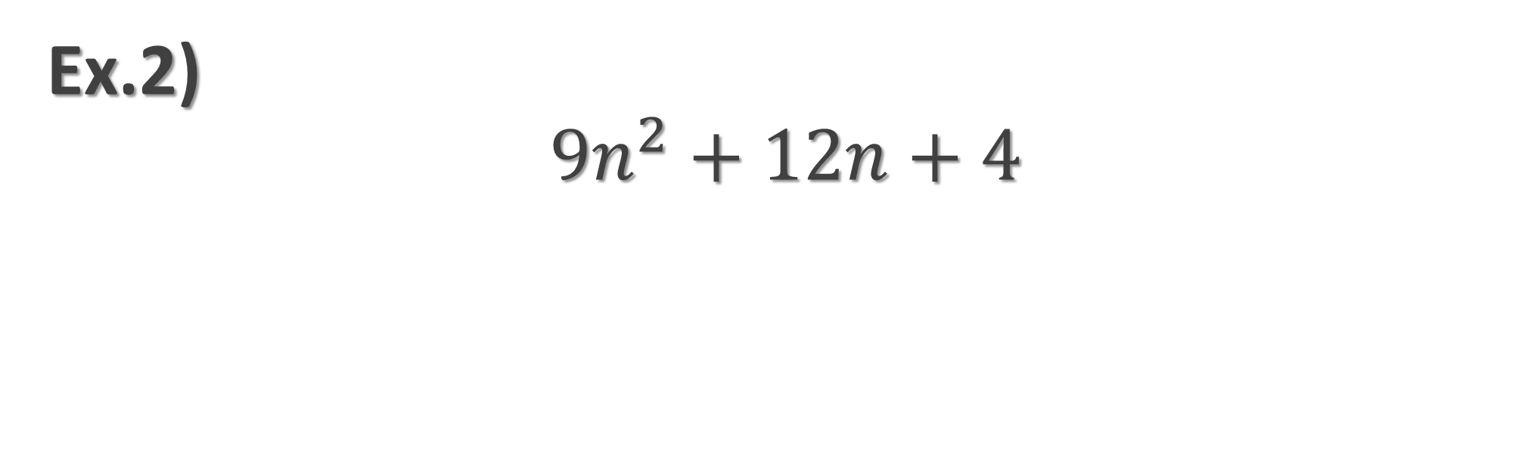
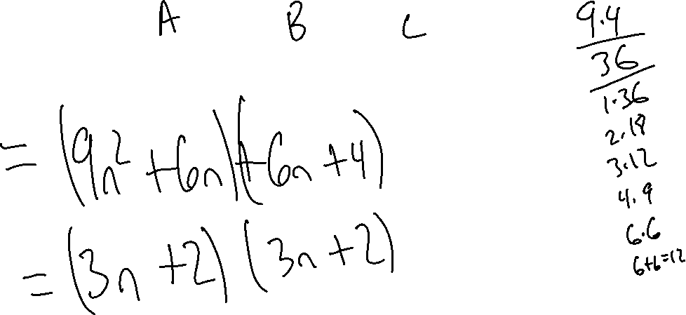
Ex.2)
$${9n}^{2}+12n+4$$

Slide 6
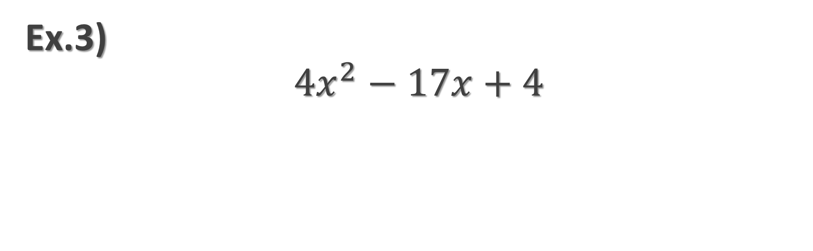
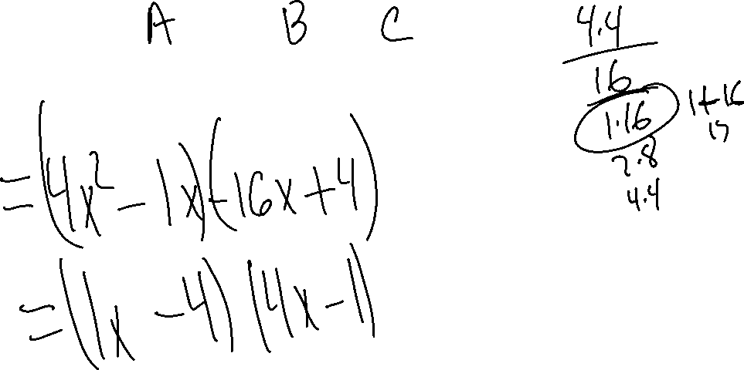
Ex.3)
$${4x}^{2}−17x+4$$

Slide 7
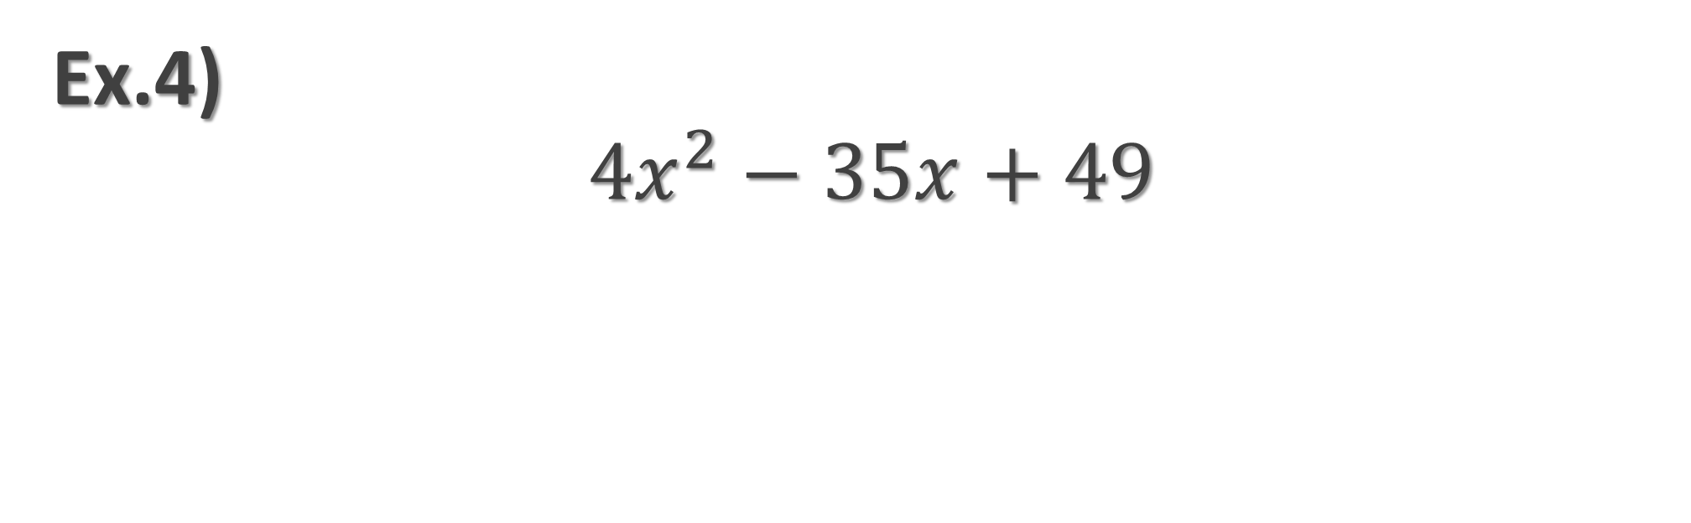
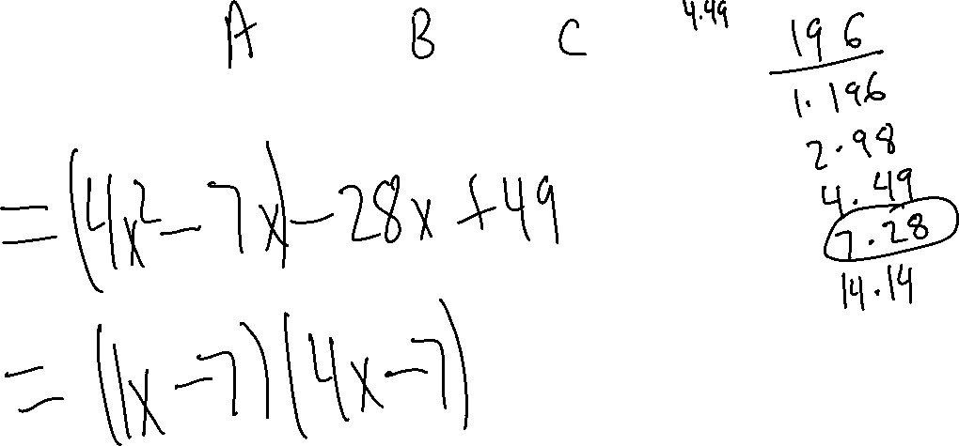
Ex.4)
$${4x}^{2}−35x+49$$

Slide 8

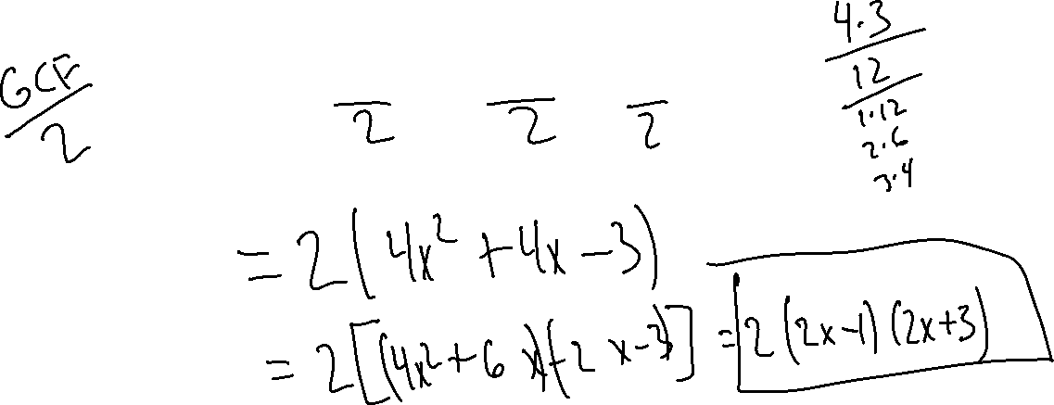
Ex.5)
$${8x}^{2}+8x−6$$

Slide 9

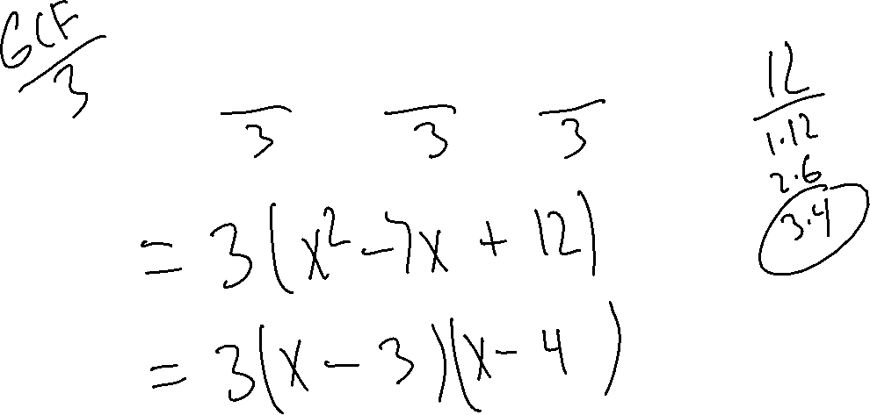
Ex.6)
$${3x}^{2}−21x+36$$

